Slide 1
Visual memory task
Pilot 1 + 2

Slide 2
Pilot 1
83 total subjects
34 qualified subjects
Qualifications :
1/1 in demo encoding attention task
Demo test accuracy above 0.5
Encoding attention check above 0.6
Response time bellow 10 seconds and above 300 ms
Notes:
0.8 in encoding attention
Criterions – how many subjects got rejected

Slide 3
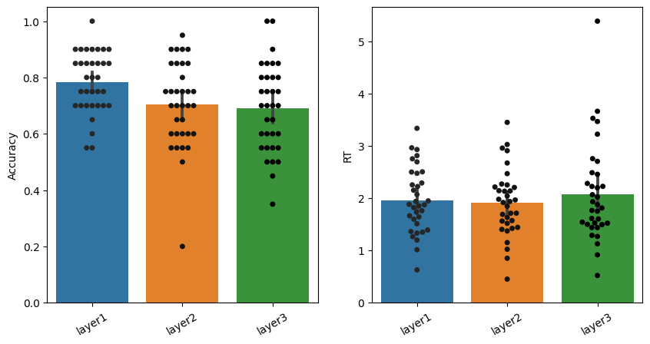

Slide 4
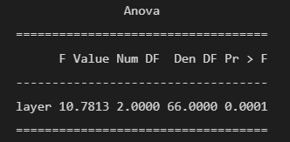
Correlation between accuracy and rt is 0.03
ANOVA results :

Slide 5
Testing qualifications for inclusion
Qualification |  | P - value | Passed mean | Failed mean
Demo accuracy | t((36, 43)) = 4.747 | p = 0.004 | 0.67 | 0.61
Demo attention | t((42, 37)) = 2.175 | p = 0.053 | 0.66 | 0.63
Encoding accuracy | t((36, 43)) = 2.443 | p = 0.017 | 0.69 | 0.63
Response strike | t((67, 12)) = 4.568 | p = 0.00 | 0.68 | 0.53
Not too fast | t((59, 20)) = 7.949 | p = 0.00 | 0.71 | 0.52
Not too slow | t((74, 5)) = -0.860 | p = 0.75 | 0.65 | 0.66

Slide 6
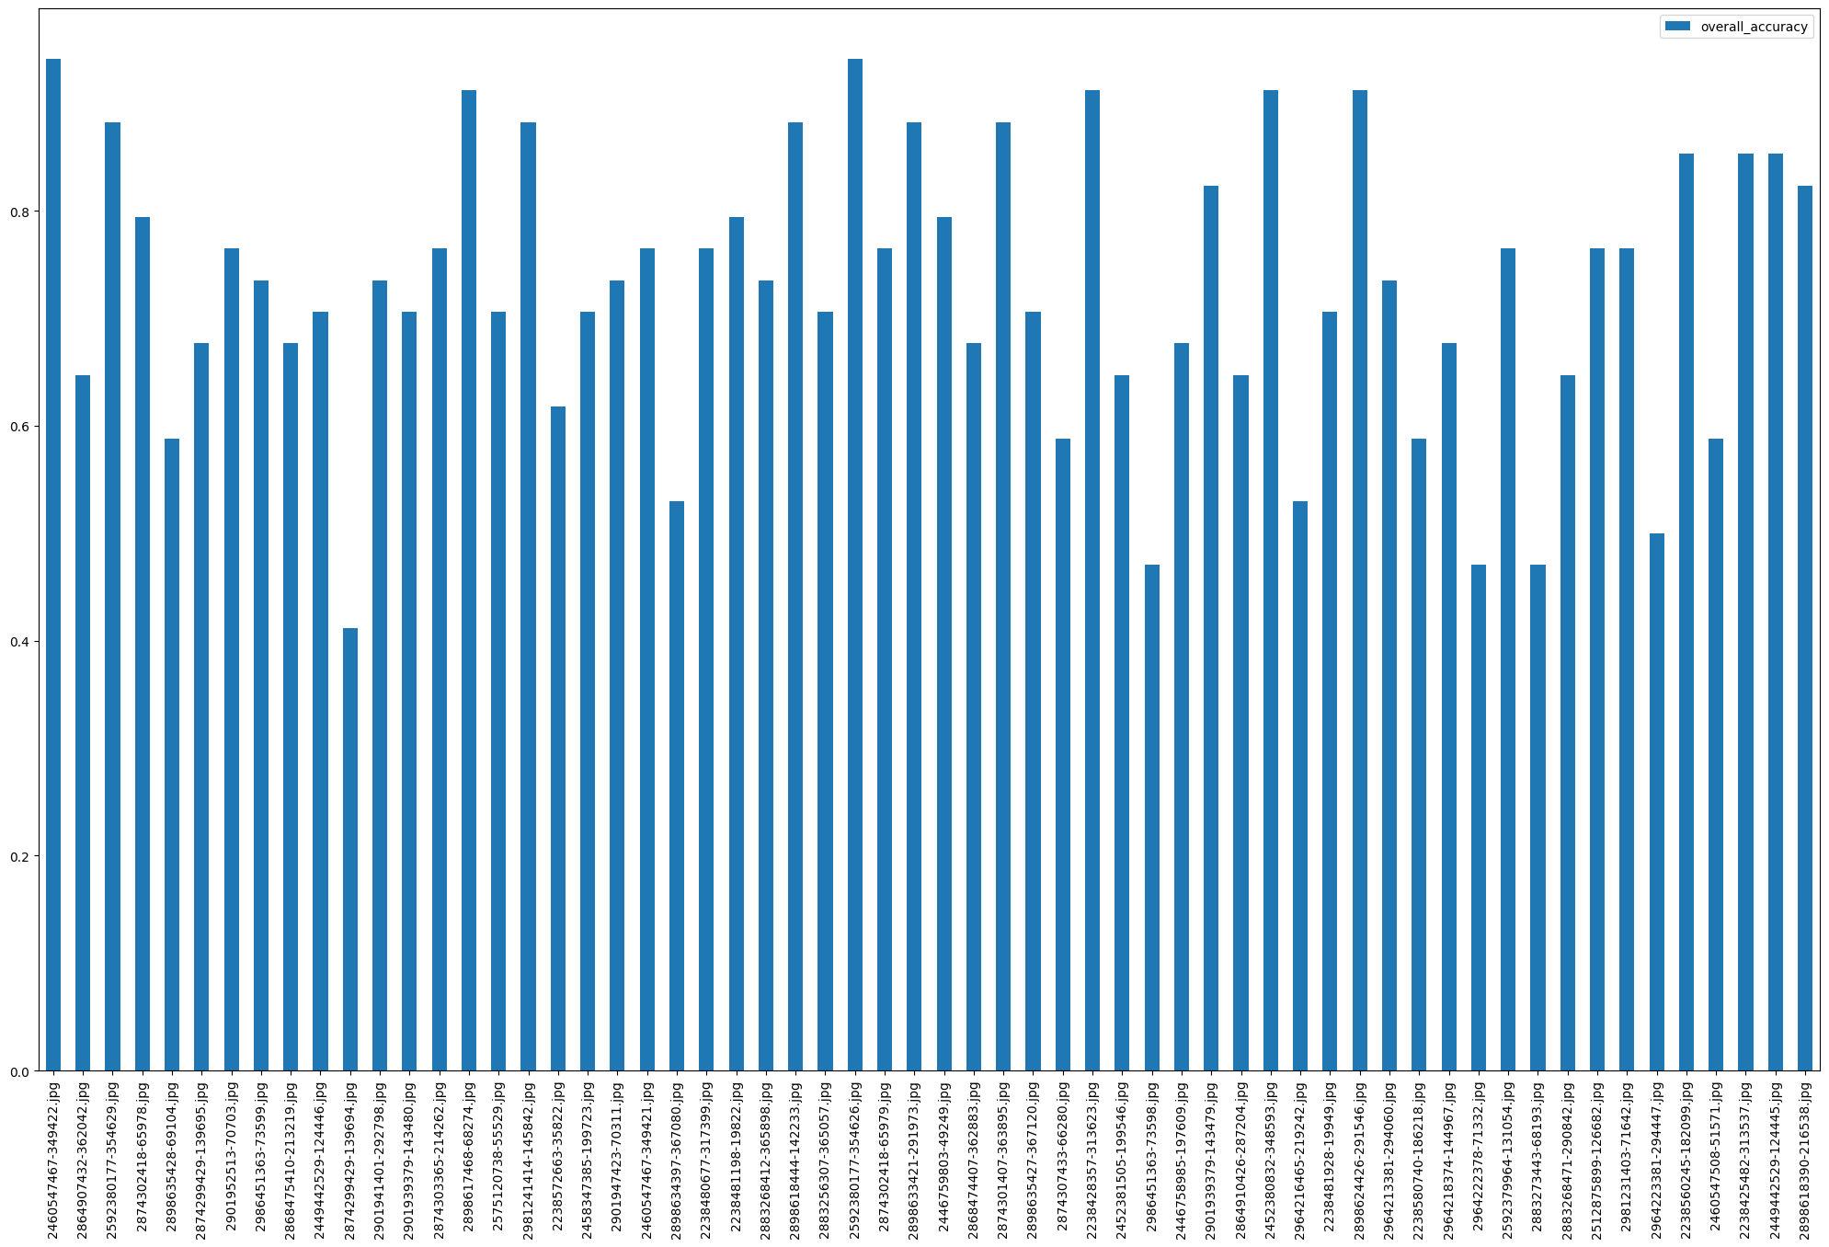
Should we replace any of the 60 target images?

Slide 7
Pilot 2
58 total participants
28 qualified participants

Slide 8
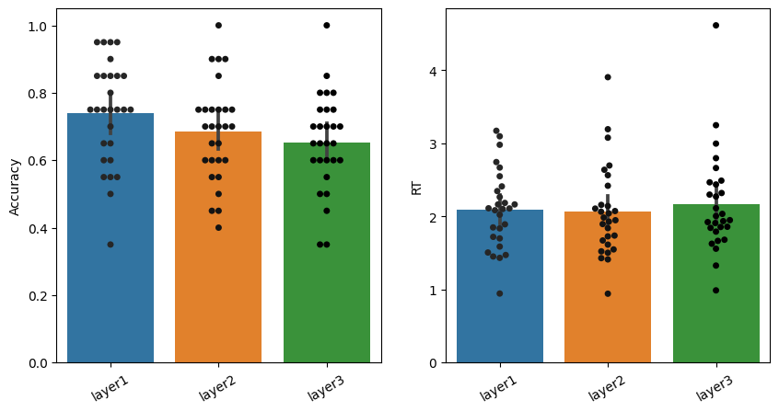
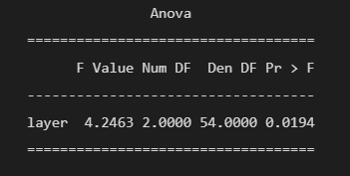

Slide 9
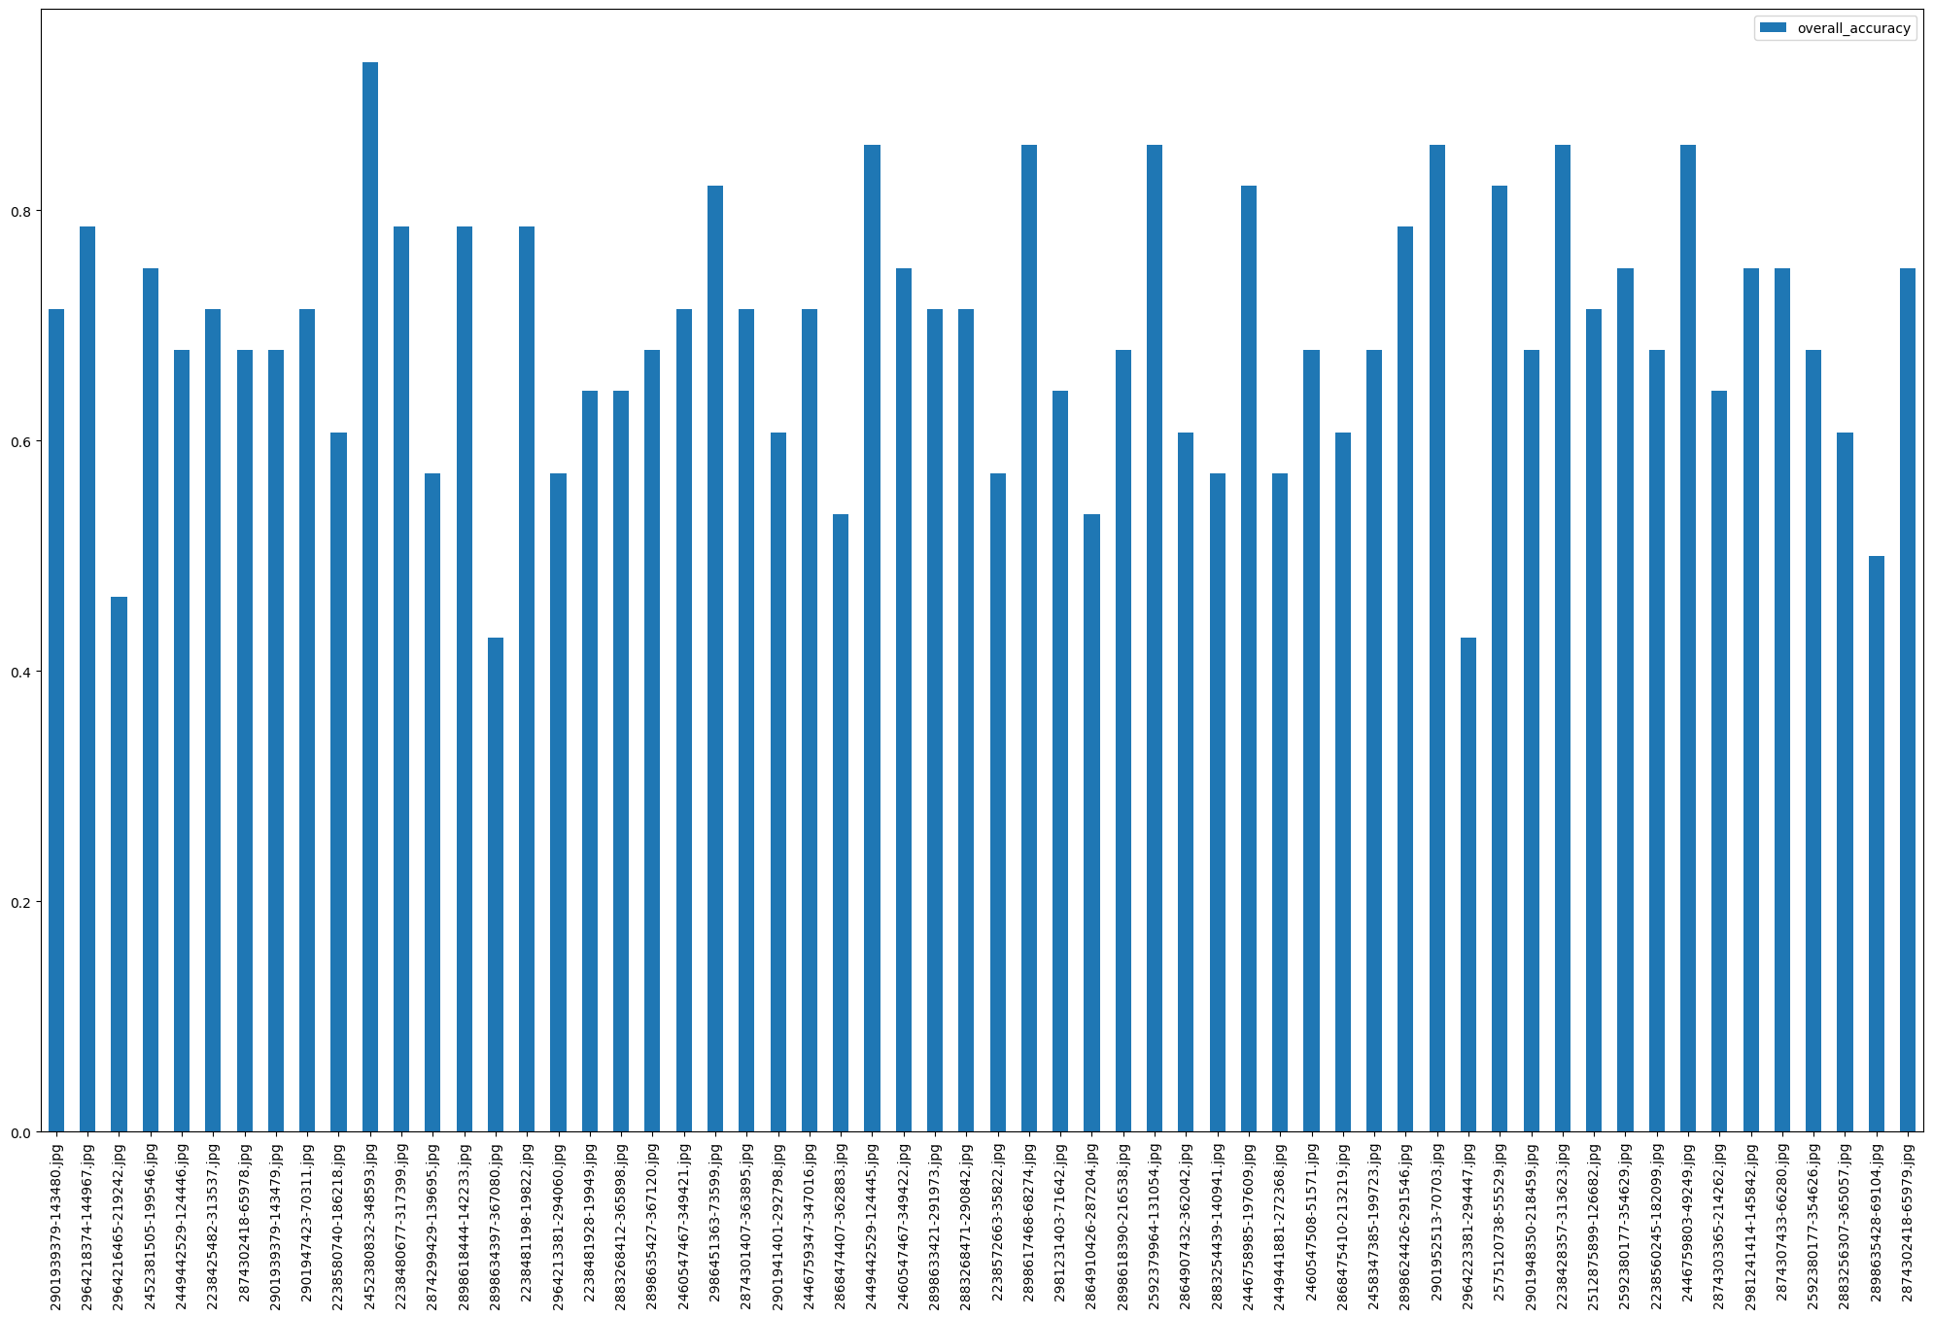

Slide 10
Pilot 1 + Pilot 2
187 total subjects
62 qualified subjects

Slide 11
Testing qualifications for inclusion
Qualification |  | P - value | Passed mean | Failed mean
Demo accuracy | t((132, 55)) = 3.5 | p = 0.001 | 0.66 | 0.60
Demo attention | t((133, 54)) = 1.54 | p = 0.125 | 0.65 | 0.62
Encoding accuracy | t((100, 87)) = 5.064 | p = 0.000 | 0.68 | 0.60
Response strike | t((166, 21)) = 4.72 | p = 0.00 | 0.66 | 0.53
Not too fast | t((147, 40)) = 6.931 | p = 0.00 | 0.67 | 0.54
Not too slow | t((173, 14)) = -0.873 | p = 0.384 | 0.64 | 0.67

Slide 12
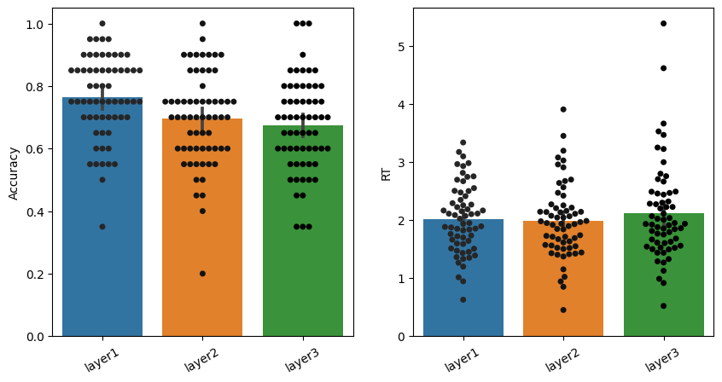
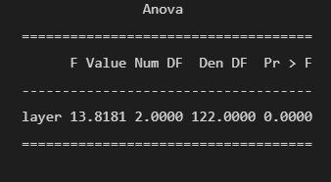

Slide 13
